Slide 1

School Of Computer Engineering
MINOR PROJECT
Tomato Disease Classification

Slide 2




GROUP MEMBER
Utpal Kant Singh
(20051117)
Rajnish Kumar
(2005118)
Saurabh Kumar
(20051096)
Shibasish Kar
(2005335)
Under The Guidance of, Dr. Santosh Kumar Baliarsingh

Slide 3
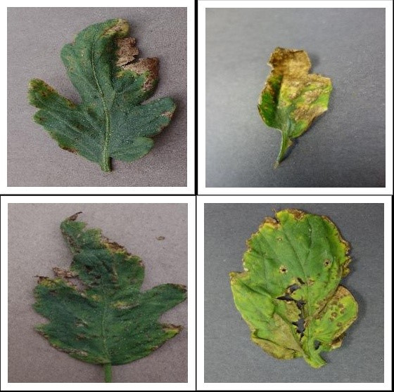
PROJECT TITLE
Designing Model For Detecting Tomato Leaf Disease Using CNN.

Slide 4

Introduction
The most extensively grown vegetable crop in Indian agricultural lands is the tomato. India's tropical climate is perfect for its growth, however some climatic circumstances and a number of other things interfere with tomato plants' typical growth. In addition to these climate factors and natural calamities, plant diseases pose a serious threat to agricultural production and are a significant contributor to financial loss. Traditional disease detection techniques for tomato crops did not yield the desired results, and disease detection times were lengthy. Compared to the current detection models, early illness detection can produce superior results. Deep learning techniques could be applied to computer vision technology as a result for earlier disease detection.

Slide 5
Environment For Implementing
Programming Language: Python
Data Taken From: Kaggle
Preferred Libraries: Tensorflow, Matplotlib, Keras, Pandas
IDE: Jupyter Notebook
Documentation: LateX

Slide 6
LITERATURE SURVEY
PRAJWALA TM ET AL, PROPOSED A CNN-BASED LENET MODEL. THE PROPOSED MODEL ACHIEVED AN AVERAGE ACCURACY OF 94-95%. MERITS INCLUDE ACCURATE DETECTION WITH LESS COMPUTATIONAL EFFORT.
MOHAMMED BRAHIMI ET AL, PROPOSED CONVOLUTIONAL NEURAL NETWORK FOR IMPROVED CLASSIFICATION THE TRAINED MODEL ACHIEVES 99.18% OF ACCURACY. MERITS INCLUDE HIGH PERFORMANCE.
SANTOSH ADHIKARI ET AL, PROPOSED A MACHINE LEARNING MODEL WITH CNN ARCHITECTURE, AND DATA AUGMENTATION REDUCES OVERFITTING DURING TRAINING THE MODEL. THUS OVERALL ACCURACY OF 89% IS OBTAINED.

Slide 7
LITERATURE SURVEY
JIA SHIJIE ET AL, PROPOSED CNN NETWORK-BASED VGG16 MODEL. THE VGG IS GOOD IN IMAGE CLASSIFICATION AND LOCALIZATION PROBLEMS. OVERALL 89% OF CLASSIFICATION ACCURACY IS ACHIEVED. MERIT INCLUDES, THE PROPOSED MODEL IS VERY EFFECTIVE. DEMERITS INCLUDE RELATIVELY HIGH-QUALITY TEST IMAGES THAT ARE ONLY USED.
THAIR A.SALIH ET AL, PROPOSED A DEEP LEARNING CNN BASED MODEL THAT ACHIEVED A CLASSIFICATION ACCURACY OF 96.43%. THE MERITS INCLUDE RECOGNITION AND DETECTION IN A SHORT TIME. DEMERITS INCLUDE A LONG DURATION IN TRAINING AND DETERMINING THE RESOLUTION OF INPUT IMAGES.

Slide 8
LITERATURE SURVEY
WE DRAW THE CONCLUSION FROM THE SURVEY THAT THE MAJORITY OF PLANT LEAF DISEASE DETECTION EMPLOYED CNN TECHNIQUES. DEEP CNN TECHNIQUES INCREASED THE DETECTION RATE, AND OBJECT DETECTION MODELS MADE THE CLASSIFICATION PROCESS NOTICEABLY QUICKER. THESE APPLICATIONS SHOW THAT CNN NEEDS A SECOND MODEL IN ORDER TO BOOST MODEL PERFORMANCE AND OVERALL ACCURACY. THE SURVEY LEADS US TO THE CONCLUSION THAT THE CURRENT MODELS PRODUCE MORE ACCURATE RESULTS. HOWEVER, THOSE MODELS WEREN'T ABLE TO IDENTIFY DISEASE AT AN EARLIER STAGE. SO, FOR THE PURPOSE OF EARLY DISEASE DETECTION OF TOMATO LEAF DISEASE, WE PROPOSE A HYBRID CNN-RNN MODEL.

Slide 9
REFERENCES
[1] Hepzibah Elizabeth, K. Ramalakshmi. "Literature Review of Disease Detection in Tomato Leaf using Deep Learning Techniques." 2021 7th International Conference on Advanced Computing and Communication Systems (ICACCS)
[2] Prajwala TM, Alla Pranathi, Kandiraju Sai Ashritha, Nagaratna B. Chittaragi*, Shashidhar G. Koolagudi. "Tomato Leaf Disease Detection using Convolutional Neural Networks." Proceedings of 2018 Eleventh International Conference on Contemporary Computing (IC3), 2-4 August, 2018, Noida, India
[3] Ayesha Batool, Syeda Basmah Hyder, Aymen Rahim, Namra Waheed, Muhammad Adeel Asghar, Fawad . "Classification and Identification of Tomato Leaf Disease Using Deep Neural Network" DOI: 10.1109/ICEET48479.2020.9048207

Slide 10


THANK YOU!

